Slide 1

Product Technical Training
Module 2. Using Tortoise SVN

Slide 2
Need for SVN
Large, fast-changing projects with many authors need a Version Control System to track changes and avoid general chaos.
A good VCS does the following:
Backup and Restore.
Synchronization
Short-term undo
Long-term undo.
Track Changes.
Track Ownership.
Sandboxing
Branching and merging.
Notes:
Backup and Restore. Files are saved as they are edited, and you can jump to any moment in time. Need that file as it was on Feb 23, 2007? No problem.
Synchronization. Lets people share files and stay up-to-date with the latest version.
Short-term undo. Monkeying with a file and messed it up? (That’s just like you, isn’t it?). Throw away your changes and go back to the “last known good” version in the database.
Long-term undo. Sometimes we mess up bad. Suppose you made a change a year ago, and it had a bug. Jump back to the old version, and see what change was made that day.
Track Changes. As files are updated, you can leave messages explaining why the change happened (stored in the VCS, not the file). This makes it easy to see how a file is evolving over time, and why.
Track Ownership. A VCS tags every change with the name of the person who made it. Helpful for blamestorming giving credit.
Sandboxing, or insurance against yourself. Making a big change? You can make temporary changes in an isolated area, test and work out the kinks before “checking in” your changes.
Branching and merging. A larger sandbox. You can branch a copy of your code into a separate area and modify it in isolation (tracking changes separately). Later, you can merge your work back into the common area.

Slide 3
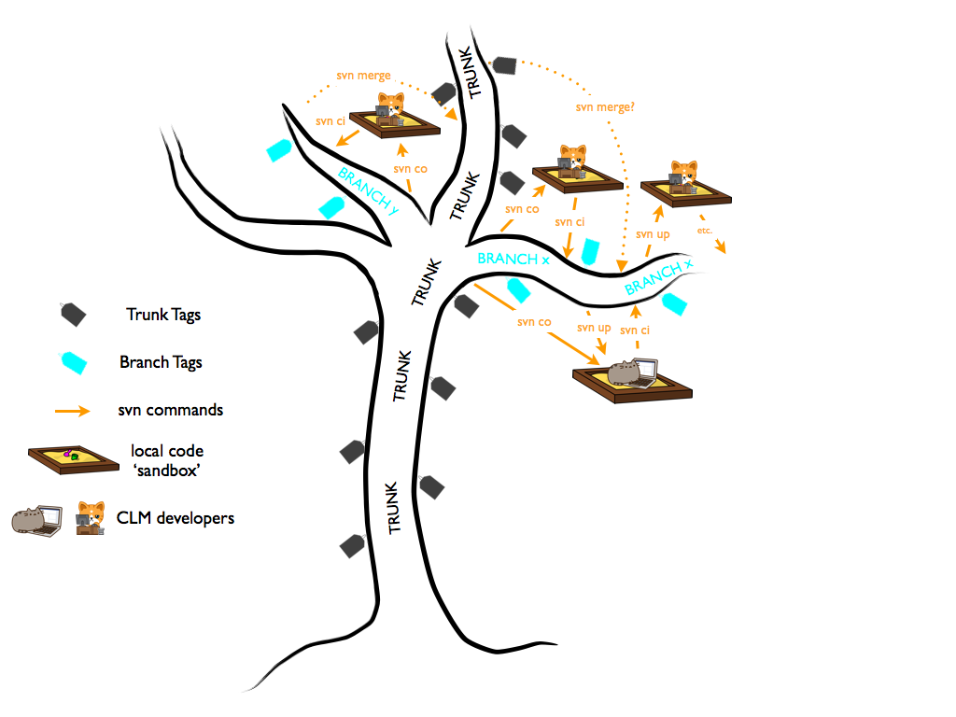
SVN Basic Terms and Structure
Repository (repo): is a central store where the project is maintained.
Server: The computer storing the repo.
Client: The computer connecting to the repo.
Working Set/Working Copy: Your local directory of files, where you make changes.
Trunk: Contains the Main code
Branch: Is an experimental version for any code change
Tag: Has a workable version of the Project.
Notes:
Repository : In fact, a SVN repository is typically used to store all the files and directories that make up a single project, or perhaps even a collection of interrelated projects. However unlike a normal folder on your computer that stores only the most recent copy of a collection of files, a SVN repository also stores the history of those files.
Branches are often used to try out new features without disturbing the main line of development with compiler errors and bugs. As soon as the new feature is stable enough then the development branch is merged back into the main branch (trunk).
Tag: Another feature of version control systems is the ability to mark particular revisions (e.g. a release version), so you can at any time recreate a certain build or environment. This process is known as tagging. It should not be modified or worked upon.

Slide 4
Actions on SVN
Check out: obtain a working copy from the repository.
Update: The process of getting changes from the repository to your local copy.
Revert: reverts all changes made to a file / folder since the last update..
Commit: Sending the changes you made from your working copy to the repository.
Commit Message: A short message describing what was changed.
Show Log: A list of changes made to a file/folder since it was created.
Check for Modifications: will show you every file that has changed in any way in your working copy.
Check Repository: Show changes in the repository

Slide 5
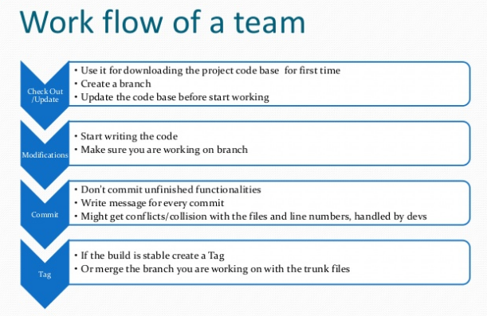

Slide 6
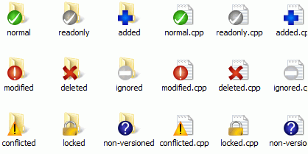
Status Information

Slide 7
Best Practices
Always do update before starting work.
Always WRITE a meaningful comment when you do commit.
Ignore file like .pdb, .suo from being checked out
Take a backup before updating so that changes can be reverted.
Do a “Check Repository / Show log” before committing changes.
Commit twice if there are formatting changes.
Commit small autonomous changes

Slide 8
Task
Setup TS code and Upsize database from the latest version
Links to the Repository: SVN Links.txt
Read document 4. SettingUpTSForDevelopement-AStepByStepGuide.doc
Try out the SVN Commands on the Test Server
Read the Guideline documents
Read other documents i.e. Brand guideline and SVN

